Slide 1
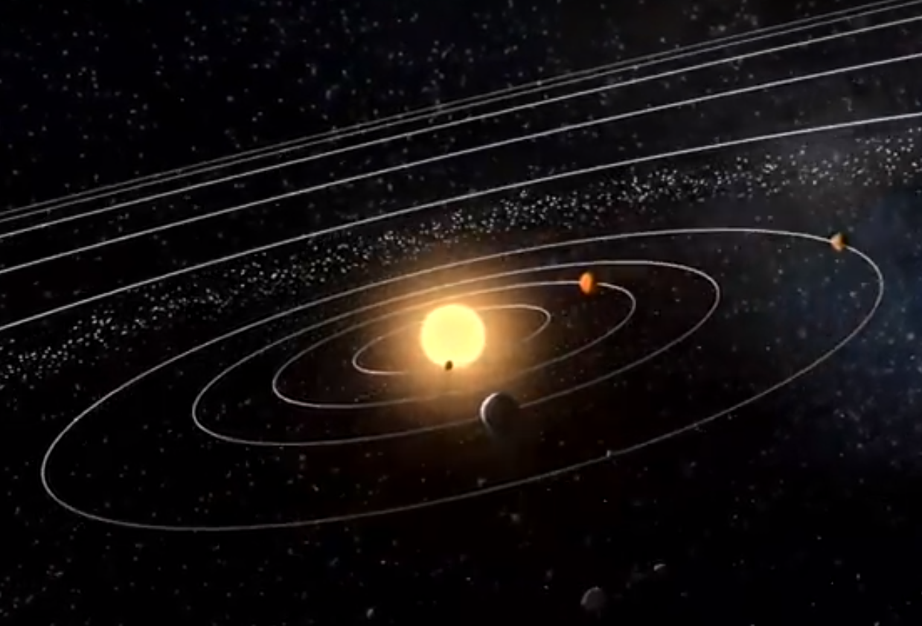
The size of space
Space is very, very big and hard to imagine.
It is so big that an accurate picture of the Solar System does not fit into a book.
Pictures that we see of the Solar System are usually wrong.
Mars
Sun
Venus
Mercury
Earth
The scale on this picture is wrong

Slide 2
The size of space
D
1. How big is the Moon
compared to the Earth?
C
B
A
Earth

Slide 3
The size of space
2. How far is the Moon from the Earth?
A
B
C
D
Earth
Moon

Slide 4
The size of space
The Earth and Moon drawn to scale
Earth
Moon

Slide 5
The size of space
3. How big is the Earth
compared to the Sun?
A
Sun
B
C
D

Slide 6
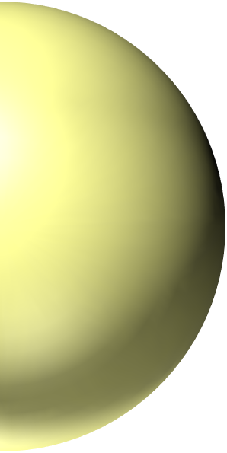
The size of space
4. How far is the Earth from the Sun?
A
B
C
Earth
D
forty-two whiteboards away
Sun

Slide 7
The size of space
The Sun, Earth and Moon drawn to scale
Moon
Earth
On this scale the Earth and Moon are
forty-two whiteboards away
Sun

